Slide 1
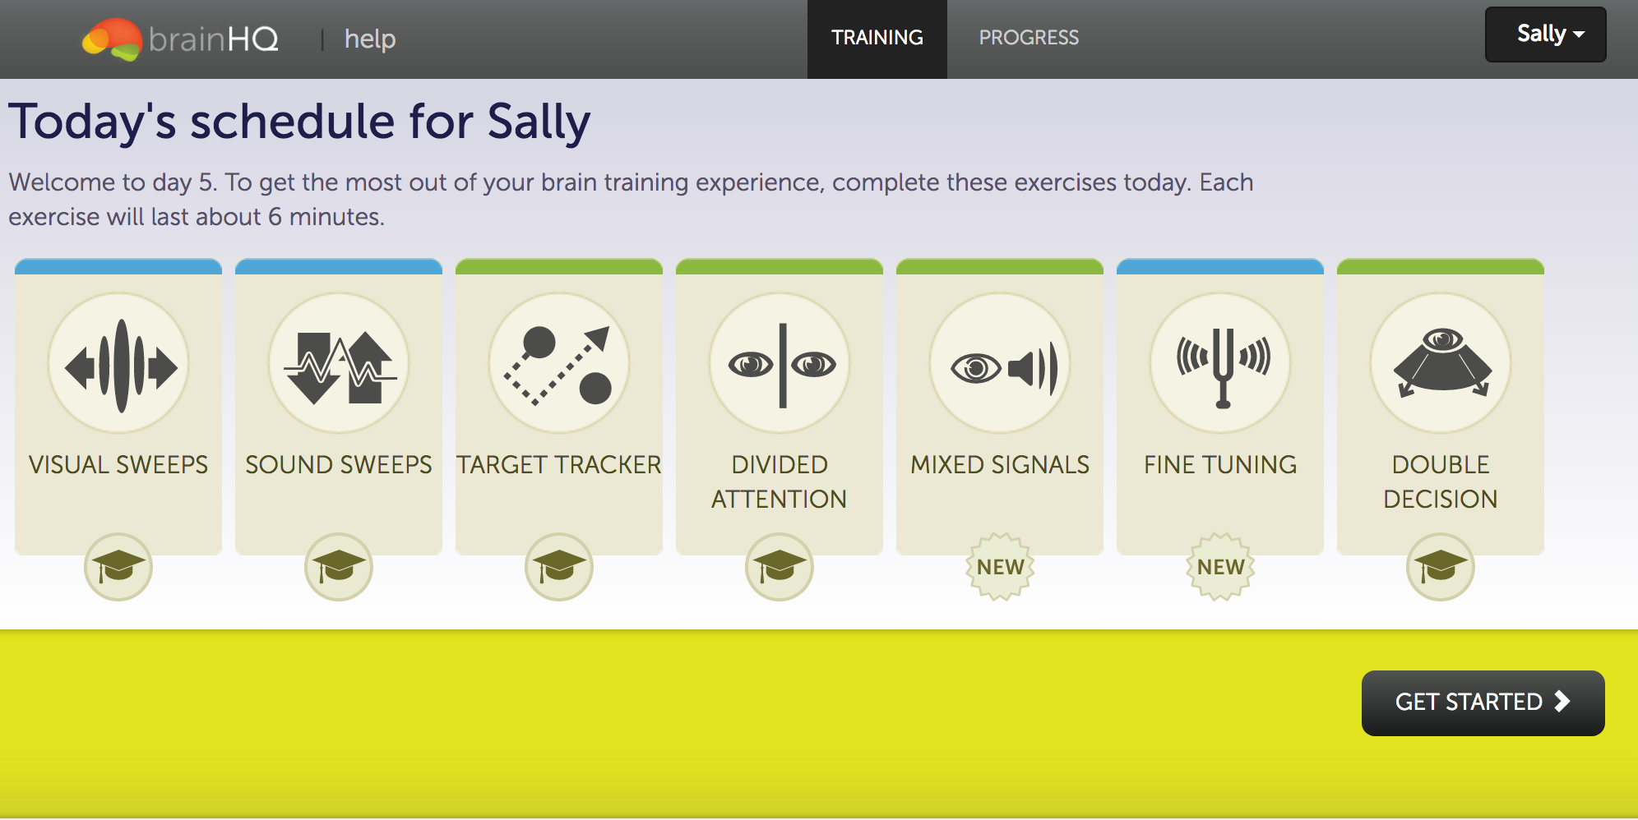
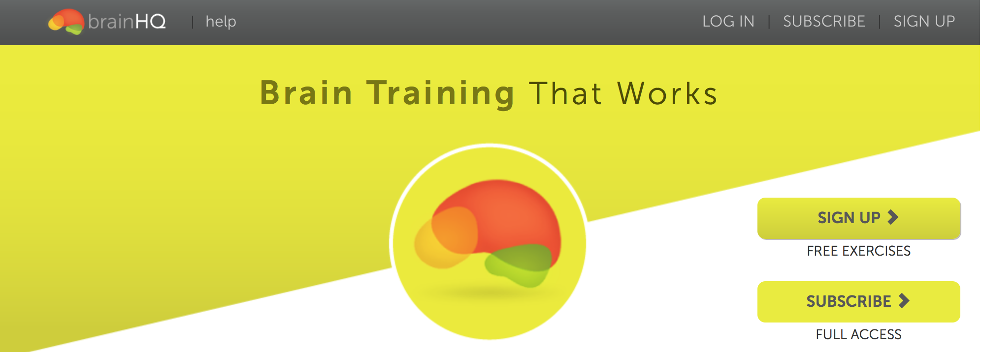
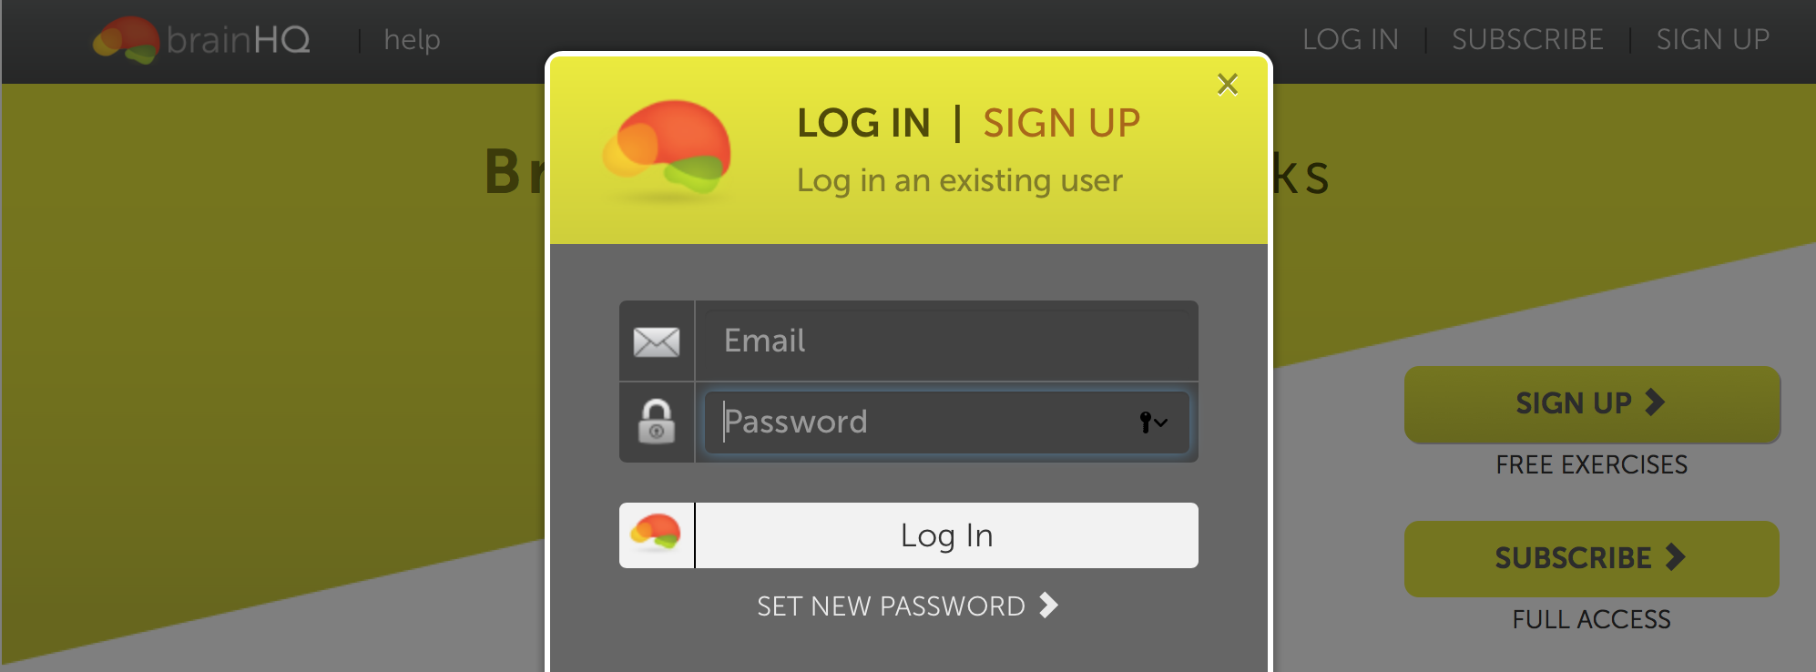
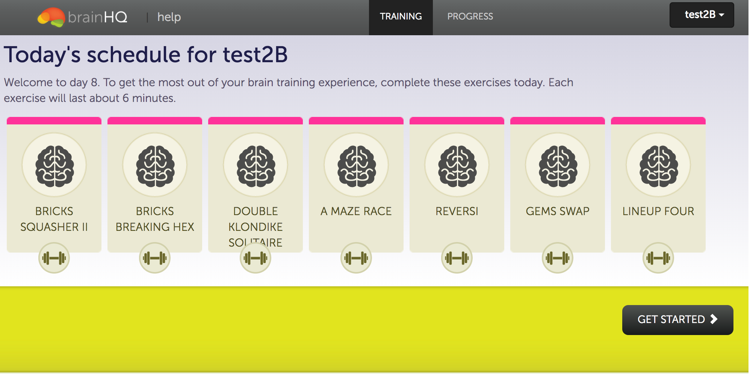
Brain Training
1. Go to Training Website
2. Login with personal ID and password
Active Control with Casual Games

Slide 2
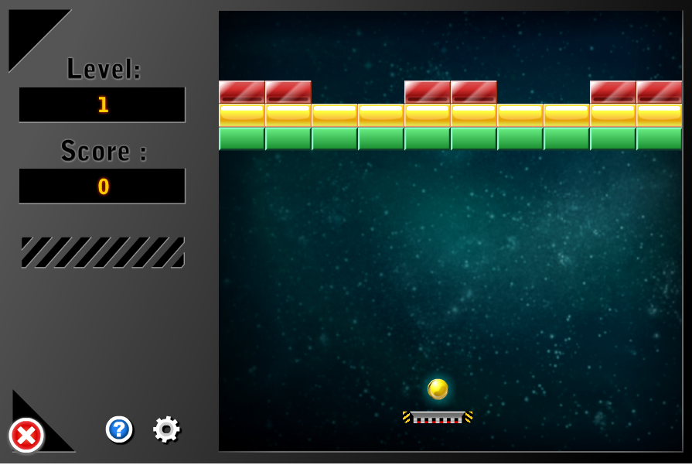
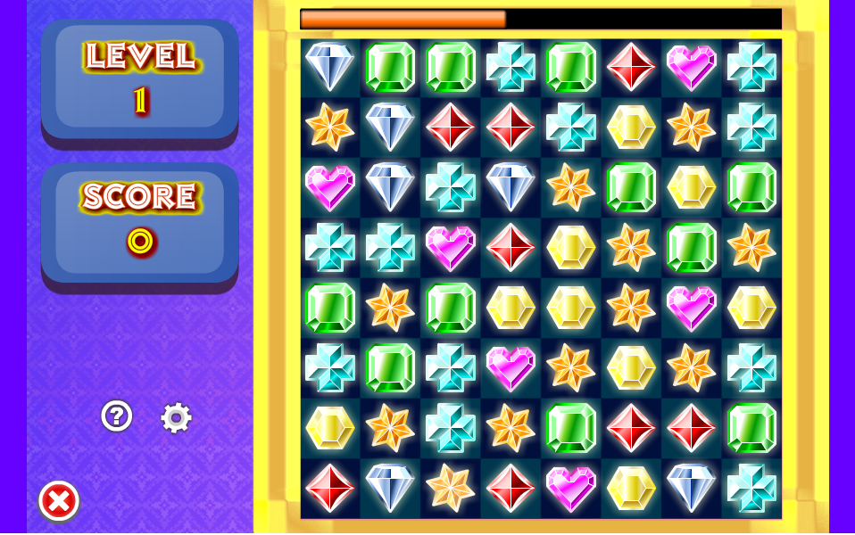
Examples of active control games. Casual games require attention, memory and executive function but are not targeted to improve cognitive processing speed and accuracy by adjusting the task difficulty based on participants’ performance. Left: Brick Breaker - participants use the paddle in order to keep the ball in the game and hit the bricks. Right: Gems Swap - participants destroy gems by creating lines of 3 or more gems of the same kind by moving the gems by using the mouse to click and swap adjacent gems.

Slide 3
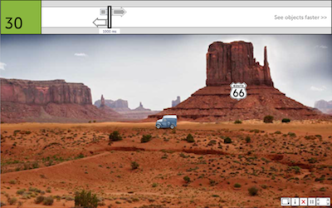


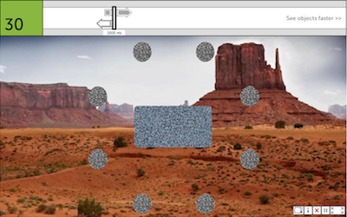
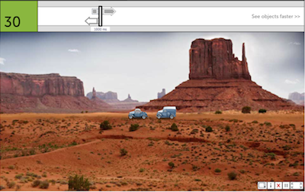
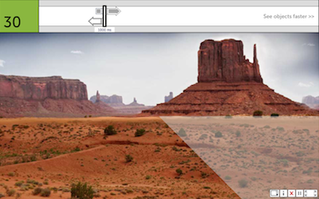
Example of CT and how it adapts difficulty based on participant’s performance
Exposure duration is adapted by performance.
If incorrect, increase exposure duration
Central and peripheral targets are presented briefly.
If correct, decrease exposure duration
Mask
Within Session: Participants played the same level multiple times until they reach the performance improvement goal. Baseline was set by the performance of very first attempt. On repetition, the initial difficulty was set by the previous trial’s best performance.
Select central target.
Between Sessions: The eccentricity of peripheral target, and the number of distractors are changed.
Select peripheral target location.

